Slide 1




WOMEN’S HACKATHON
11th Annual UMSL
2025
Empowering #WomenInTech
Brought to you by

Slide 2

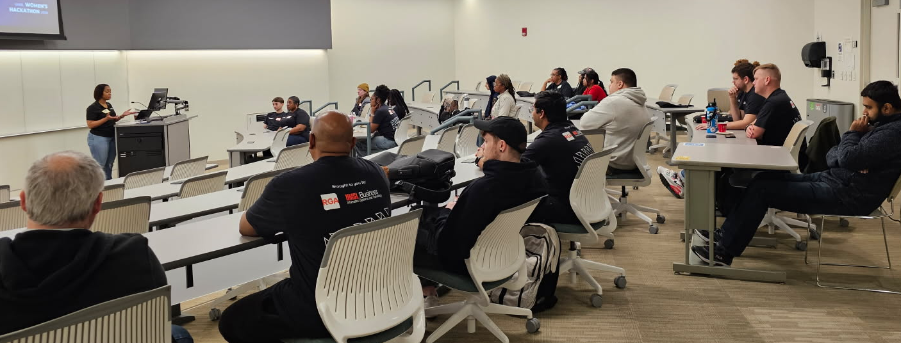
Event Highlights!
13 Hackathon Participants
3 New Solutions Created
#UMSLWomensHackathon
#UMSLProud
#WomenInTech
#WomensHackathon
Brought to you by
UMSL WOMEN’S HACKATHON 2025

Slide 3
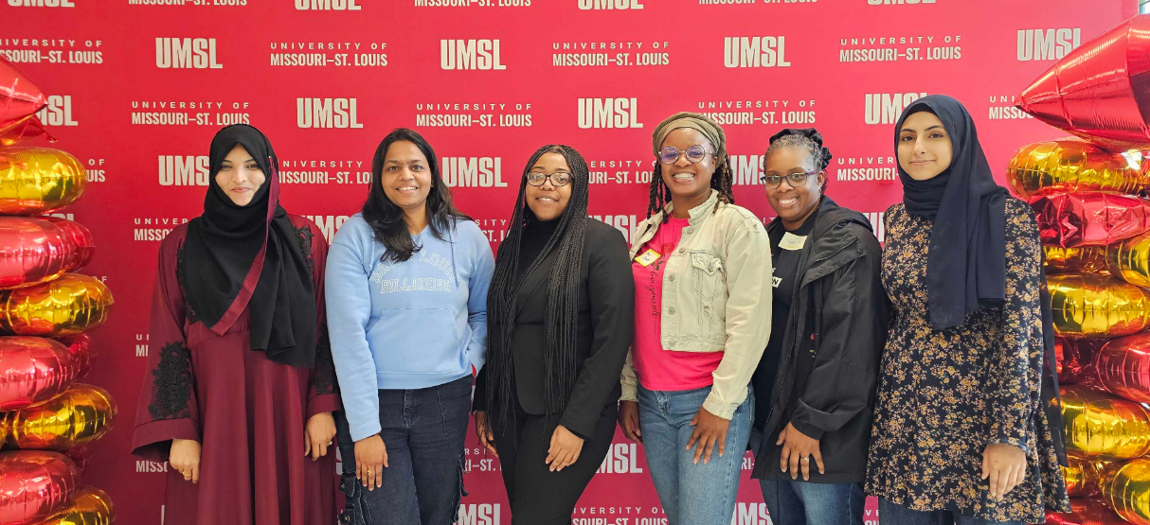
3rd Place Stock Savvy
Avee, Vani, Briaris, Tyra, Mymoon, Efta
Brought to you by
UMSL WOMEN’S HACKATHON 2025

Slide 4
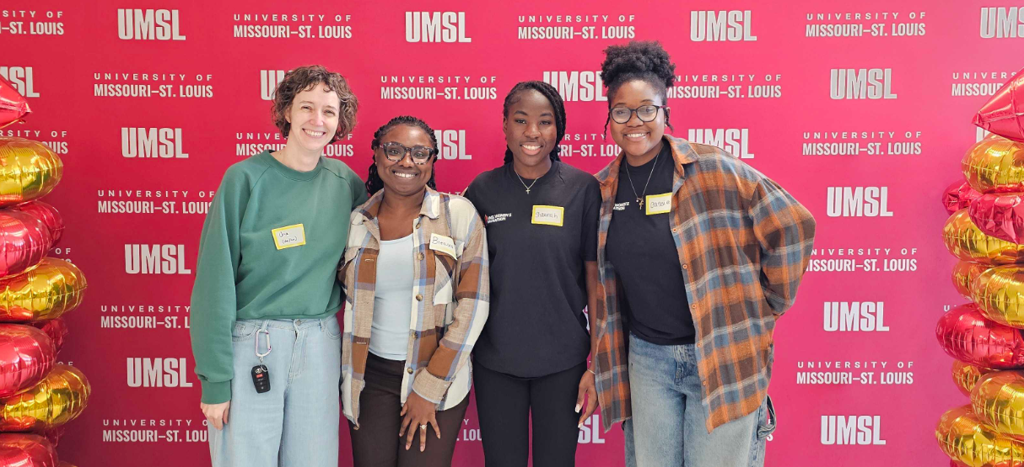
2nd Place Sisters In Christ
Cassandra, Una, Shakinah, Breanna
Brought to you by
UMSL WOMEN’S HACKATHON 2025

Slide 5
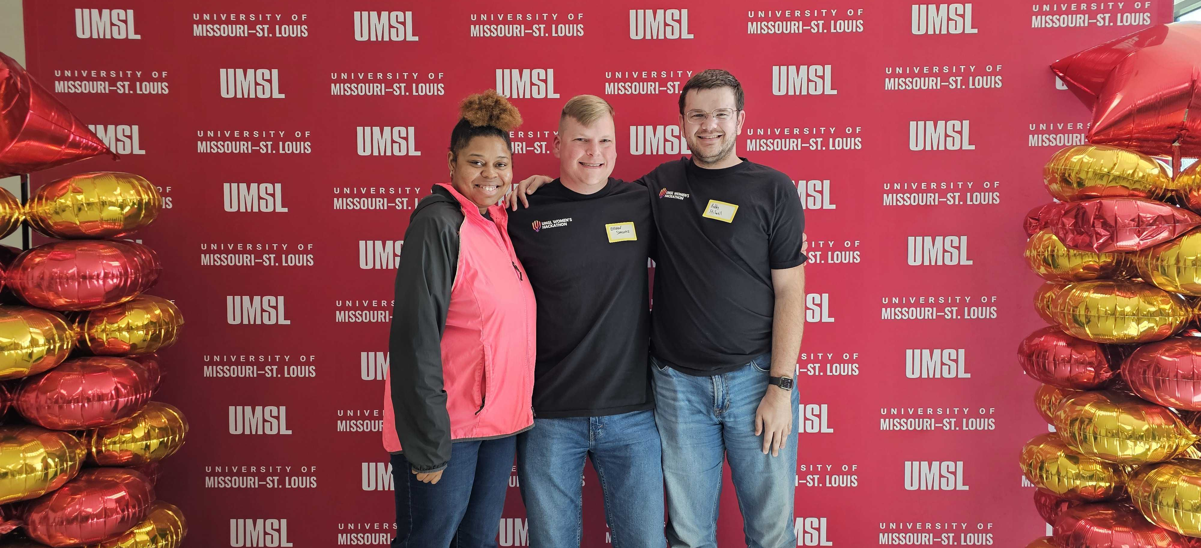
1st Place Campus Aware
Brittany, Bobby, Brian
Brought to you by
UMSL WOMEN’S HACKATHON 2025

Slide 6

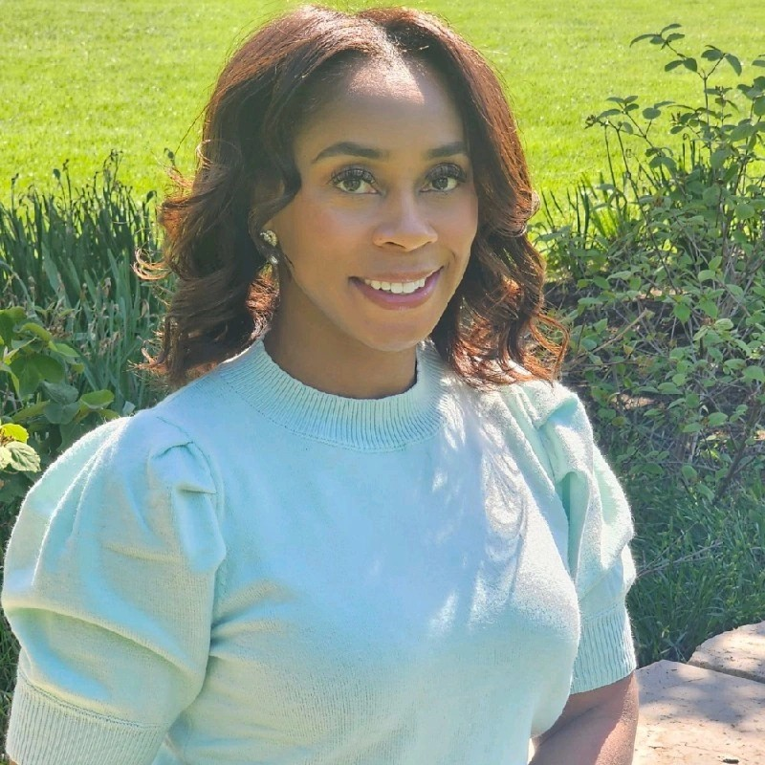
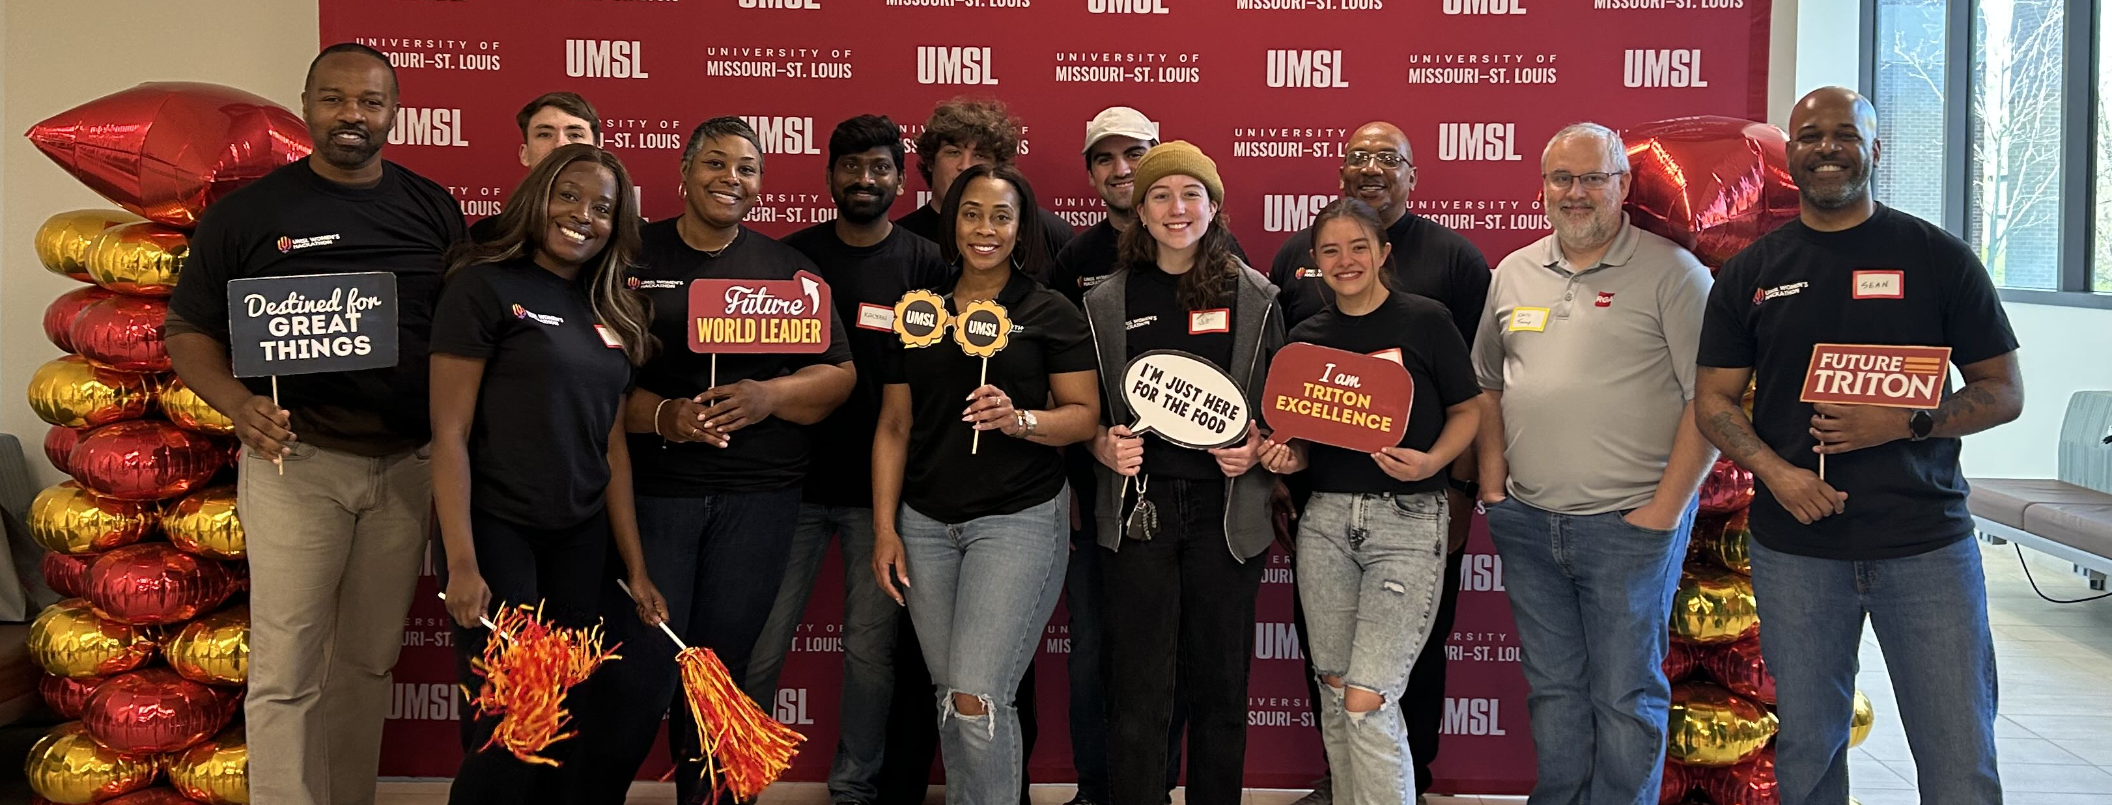
Special Thanks to:
11th Annual UMSL
WOMEN’S HACKATHON
Reinsurance Group of
America, Incorporated
rgare.com
Empowering #WomenInTech
2025
Geminia Morris
Keynote Speaker
Mentors, Volunteers, & Participants!

Slide 7
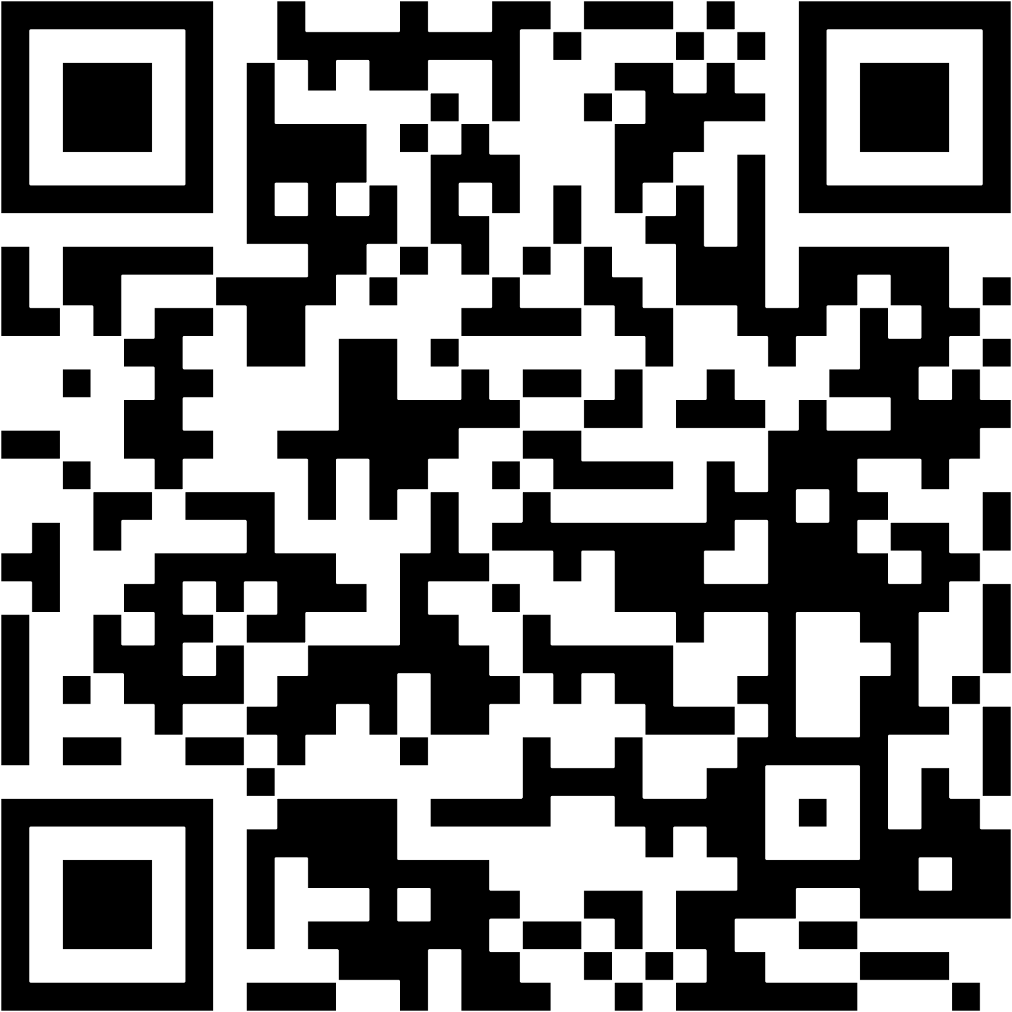
👋 Farewell & Safe Travels
Final Notes:
#UMSLWomensHackathon
#UMSLProud
Event Images
Social Media Posts
Feedback Survey
Take Your Personal Items
Take the Snacks/Food!
#WomenInTech
#WomensHackathon
UMSL WOMEN’S HACKATHON 2025

